Slide 1
Pizza Sales Prediction and Purchase Order Generation
Goal: Predict weekly pizza sales and generate a purchase order for required ingredients

Slide 2
Project Overview
Objective:
Predict pizza sales for the next week using historical sales data (from 01-01-2015 to 31-12-2015).
Generate a purchase order based on predicted sales and ingredient requirements.
Challenges:
Time series forecasting at the individual pizza level.
Aligning sales predictions with ingredient needs.
Generating accurate purchase orders.

Slide 3
Data Overview
Sales Data:
Date Range: 01-01-2015 to 31-12-2015
Columns:
pizza_name_id – Unique pizza identifier
week_number – Week number (derived from date)
quantity – Quantity sold

Slide 4
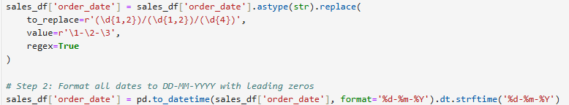
Data Preprocessing
Convert Date Format:
Convert inconsistent date formats to dd-mm-yyyy using regex:

Slide 5
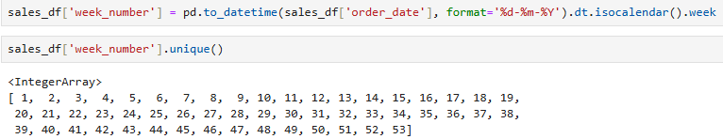
Extract Week Number:
Create a new week_number column from the order date:

Slide 6
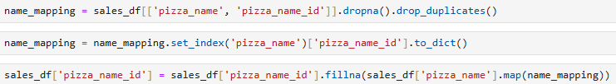
Handle Missing Pizza IDs:
Fill missing pizza_name_id values using a mapping from pizza_name:
Extract relevant columns and remove duplicates
Convert to a dictionary for quick lookup
Fill missing values using the mapping

Slide 7

Group by Pizza and Week:
Create individual dataframes for each pizza:

Slide 8
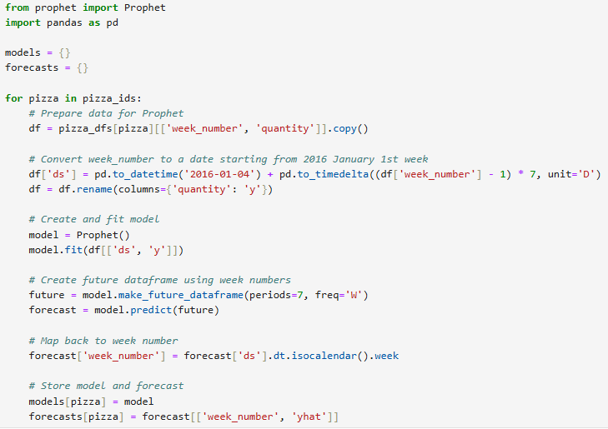
Model Training and Forecasting
This Python script uses Facebook Prophet to forecast pizza sales based on historical weekly sales data.
The goal is to predict sales for the next 7 weeks and link it back to week numbers instead of actual dates.

Slide 9
Converts week numbers into actual dates, starting from Monday, January 4, 2016.
This ensures Prophet understands the time component for forecasting.
Generates a 7-week forecast based on the trained model.
Maps the forecasted dates back to week numbers.
Stores the predicted sales (yhat) per week for future analysis.
This script trains a time-series model for each pizza type, forecasts sales for 7 future weeks, and maps predictions back to week numbers to keep the analysis week-based instead of date-based.

Slide 10
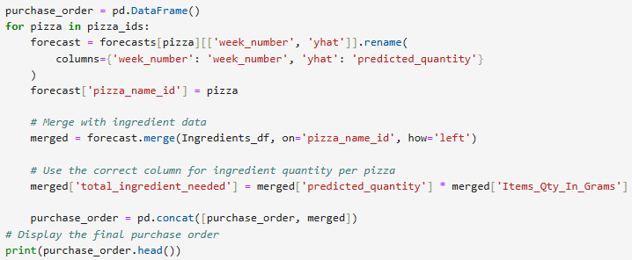
Purchase Order Generation
Predicts weekly pizza sales using Prophet.
Joins predictions with ingredient requirements.
Calculates total ingredient demand.
Generates a purchase order for ingredient procurement.

Slide 11
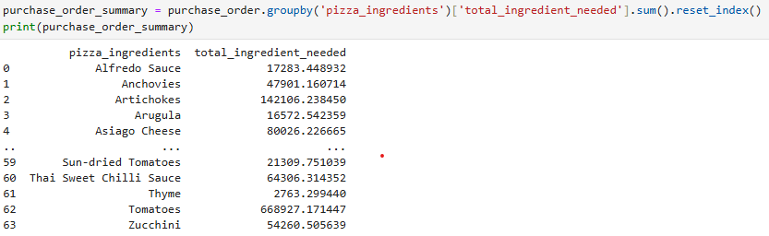
This aggregates ingredient demand across all pizzas.
The final output tells how much of each ingredient should be purchased.
Helps in inventory planning and supplier orders.

Slide 12
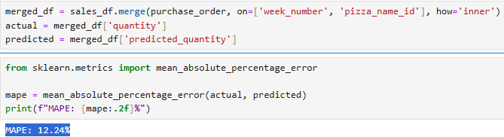
Model Evaluation
MAPE Calculation:
The Mean Absolute Percentage Error (MAPE) is a metric that measures the accuracy of your pizza sales prediction model.
On average, your predicted pizza sales are 12.24% off from the actual sales.

Slide 13
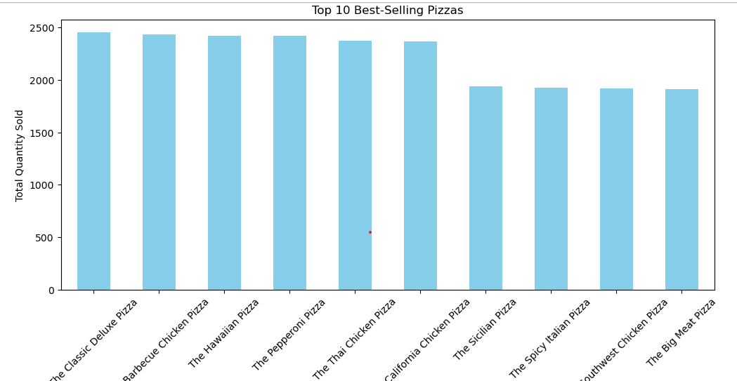
Top 10 Best-Selling Pizzas
The Classic Deluxe Pizza, Barbecue Chicken Pizza, Hawaiian Pizza, and Pepperoni Pizza are among the top sellers.
They have sales around 2,500 units each.
The Sicilian Pizza, Spicy Italian Pizza, Southwest Chicken Pizza, and Big Meat Pizza have lower sales than the top 5 but still make it to the top 10.

Slide 14
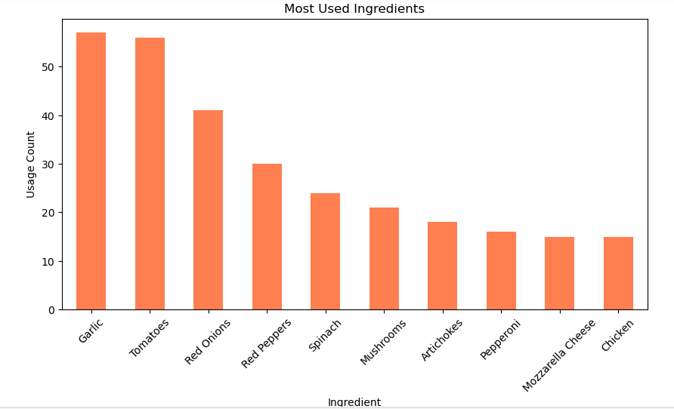
Most Used Ingredients
Garlic and Tomatoes are the most frequently used ingredients, appearing over 50 times.
Red Onions and Red Peppers follow, with moderate usage.
Other ingredients like Spinach, Mushrooms, Artichokes, Pepperoni, Mozzarella Cheese, and Chicken have lower but still significant usage counts.
This chart can help in inventory management, menu planning, and optimizing ingredient stock levels for efficient pizza production.

Slide 15
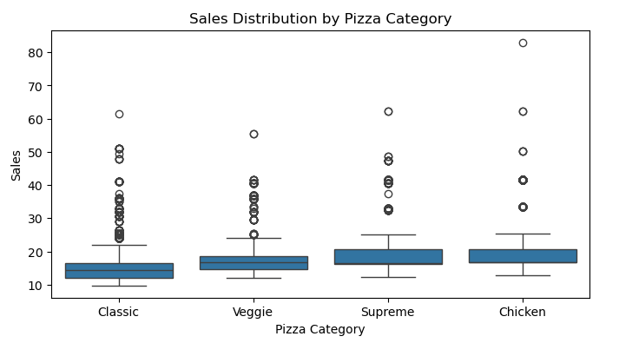
Sales Distribution by Pizza Category
Chicken and Supreme pizzas have some very high outliers, meaning a few instances of extremely high sales compared to typical values.
All categories have a similar median sales value, suggesting consistent sales performance across different pizza types.
This distribution analysis helps in inventory planning and marketing strategies for different pizza categories.

